Slide 1
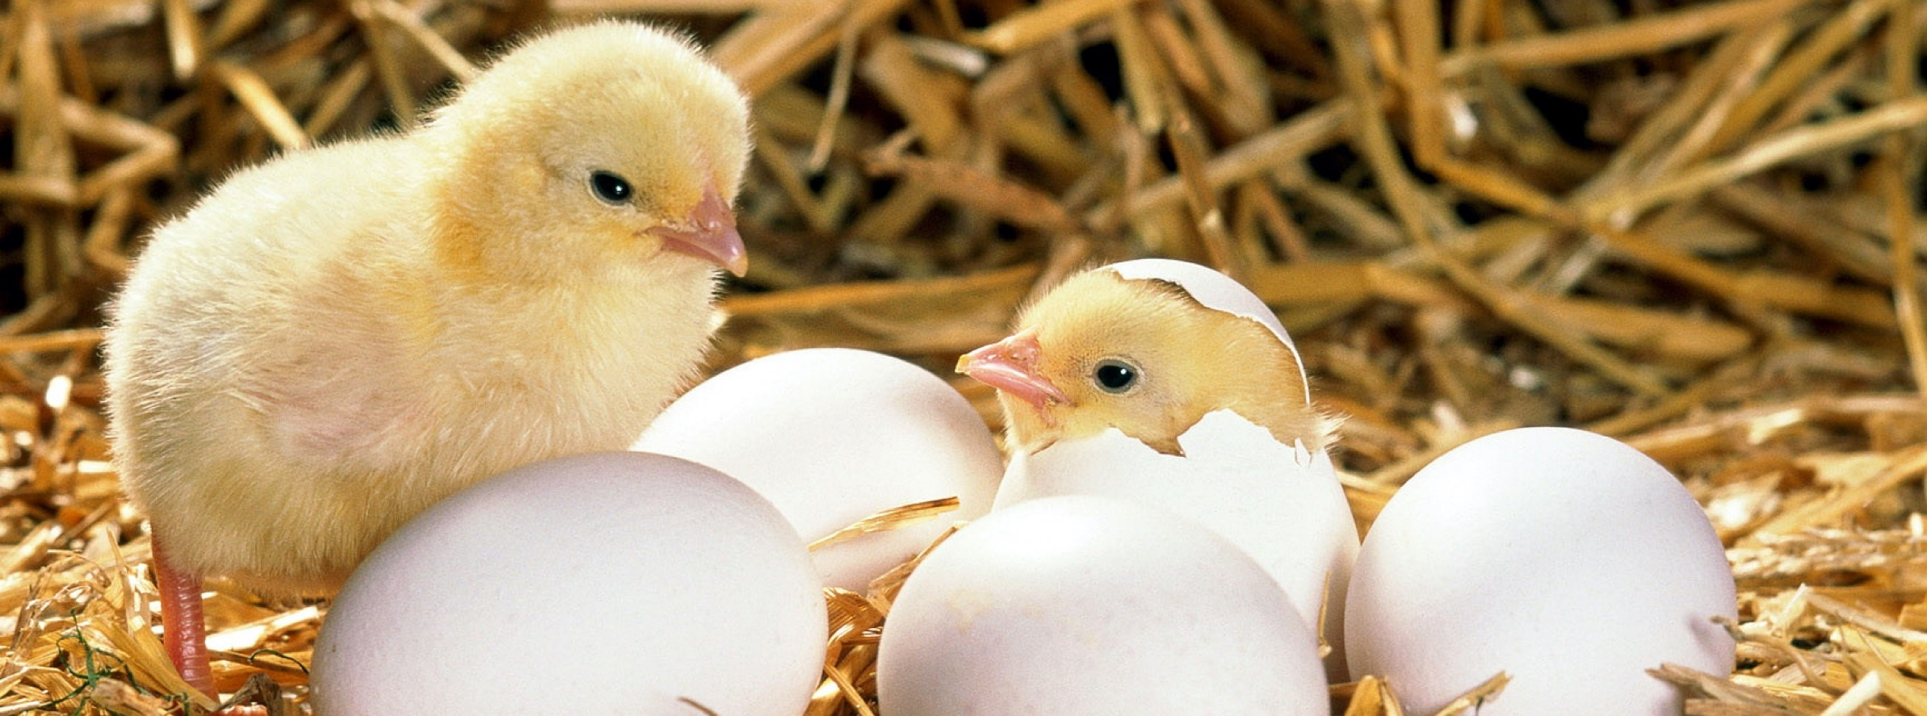
PRODUCTION OF BROILER HATCHING EGGS
INVESTMENT PROJECT
Incor, OOO
Meshchovsk District

Slide 2
GOALS AND ADVANTAGES OF THE PROJECT
PURPOSES
CREATION
INCREASE
DECREASE
SUBSTITUTION
of the domestic market of hatching eggs
of the production of poultry
of the flow of import hatching eggs
of import products by domestically produced ones
COMPETITIVE POSITION
Broiler crosses COBB 500-700
Automated equipment
Economically advantageous location of the production
Absence of concurrence in Russia

Slide 3
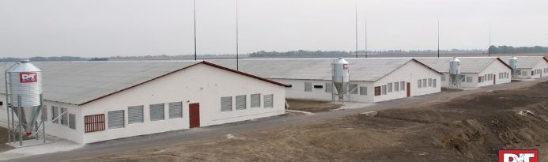
PROJECT DESCRIPTION
INDUSTRIAL COMPLEX CONSTRUCTION
Site for stockkeeping
Central egg-handling plant
Slaughterhouse, pit
Logistics centre
CONSTRUCTION PERIOD
Commencement of construction
The 1st phase of the construction, ACW of the 2nd and the 3rd order
Market launch, launch of the 2nd and 3rd order
Terms of project realization, years
2015
2016
2017
3

Slide 4
PROJECT FINANCIAL SUMMARY
Volume of investment,
million RUB
Planned capacity, million items per a year
Total revenue,
million RUB
Operating expenses,
million RUB
6 851
110
21 523
10 960
Pretax profit,
million RUB
Profit margin, %
Pay-off period from the date of its launch, years
Full cost recovery of the project, year
10 563
49
4
2024

Slide 5
EXPENSES, THOUSAND RUB
Feed additives
Veterinary preparations
Young breeders
Materials, packages
563 598
24 342
233 853
68 394
Electricity, gas, water
Payroll with extra charge
Selling expenses
Executive expenses
105 204
80 084
10 943
34 085
SUM TOTAL 1 120 503 THOUSAND RUB

Slide 6
ASSORTMENT AND PRICE POLICY
Dates of product realization, days
Sale price of production
Hatching egg
7
25 RUB per an item
Commercial egg
21
4 RUB per an item
Powdered eggs
180
120 RUB per a kg
Poultry (carcase, 1/2 carcase)
180
99 RUB per a kg
Poultry (filet)
180
150 RUB per a kg

Slide 7
SALES PLAN
IN VOLUME TERMS
2017
2018
2019
2020
2021
2022
2023
2024
2025
Всего
Hatching egg, thousand items
50 778
104 776
104 776
105 052
105 052
105 052
105 052
105 052
105 052
890 642
Commercial egg, thousand items
2 116
4 366
4 366
4 366
4 366
4 366
4 366
4 366
4 366
37 041
Poultry (carcase, ¹/₂ carcase), t
115
1 493
1 493
1 608
1 608
1 608
1 608
1 608
1 608
12 749
IN MONETARY TERMS, THOUSAND RUB
2017
2018
2019
2020
2021
2022
2023
2024
2025
Всего
Hatching egg
1 154 050
2 381 284
2 381 284
2 387 542
2 387 542
2 387 542
2 387 542
2 387 542
2 387 542
20 241 870
Commercial egg
6 994
14 432
14 432
14 470
14 470
14 470
14 470
14 470
14 470
122 678
Poultry
10 442
135 743
135 743
146 185
146 185
146 185
146 185
146 185
146 185
11 159 040
Sum, net of VAT
1 171 486
2 531 459
2 531 459
2 584 197
2 548 197
2 548 197
2 548 197
2 548 197
2 548 197
21 523 588
Sum, inclusive of VAT 10 %
1 288 635
2 784 605
2 784 605
2 803 017
2 803 017
2 803 017
2 803 017
2 803 017
2 803 017
23 675 947

Slide 8
SALES GEOGRAPHY
10
9
8
2
7
11
3
12
13
1
6
15
5
14
4
21
17
18
16
19
20
THE DELIVERY IS PLANNED TO THE CFD AND TO THE STATES OF THE FORMER SOVIET UNION
1
8
15
22
Moscow
Leningrad
Tula
Kazakhstan
2
9
16
Voronezh
Tver
Novgorod
3
10
17
Yaroslavl
Pskov
Tambov
4
11
18
N. Novgorod
Smolensk
Saratov
22
5
12
19
Samara
Vladimir
Bryansk
6
13
20
Orenburg
Kostroma
Kaluga
7
14
21
Kirov
Vologda
Kursk

Slide 9
FINANCIAL RESULTS
Investment amount, milliard RUB
Net present value,
million RUB
Internal rate of return, %
Annual net profit, milliard RUB
Average annual volume of sales, milliard RUB
6,8
235
18
1,3
>2,5
PAYBACK PERIOD
Simple, years
Discount, years
7
9

Slide 10
RISKS AND RISK SENSITIVENESS
RISKS
Quarantine restrictions on the importation of breeding material
Oversupply of hatching eggs on the Russian market
Deficiency of qualified personnel
Loss of product quality
SOLUTIONS
Project insurance
Access to the market of the neighboring countries
Training and professional development
Implementation of quality management system

Slide 11
CONTACT INFORMATION
5, Vilonova Street, Kaluga, Russia, 248000
ph.: 8 (4842) 56-30-57, 57-93-01 fax: 8 (4842) 57-54-74
kancel@adm.kaluga.ru
www.admoblkaluga.ru/sub/selhoz/
5, Vilonova Street, Kaluga, Russia, 248000 the 4th floor
ph.: 8 (4842) 22-04-32, 22-04-39
apkko@adm.kaluga.ru
www.apkko.ru

